Slide 1



The Cloud Native Platform
<team>

Slide 2
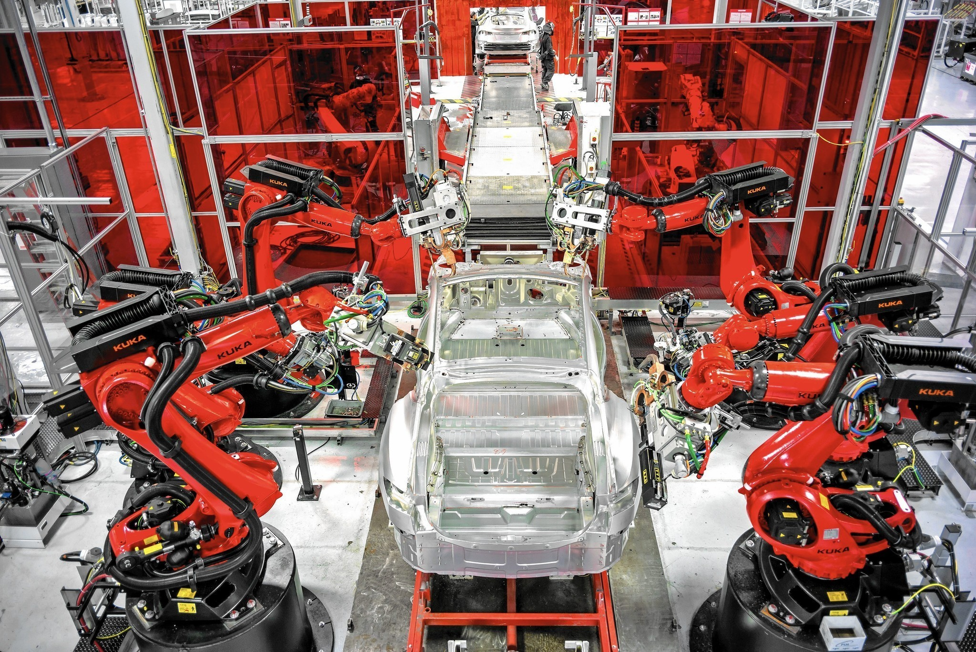
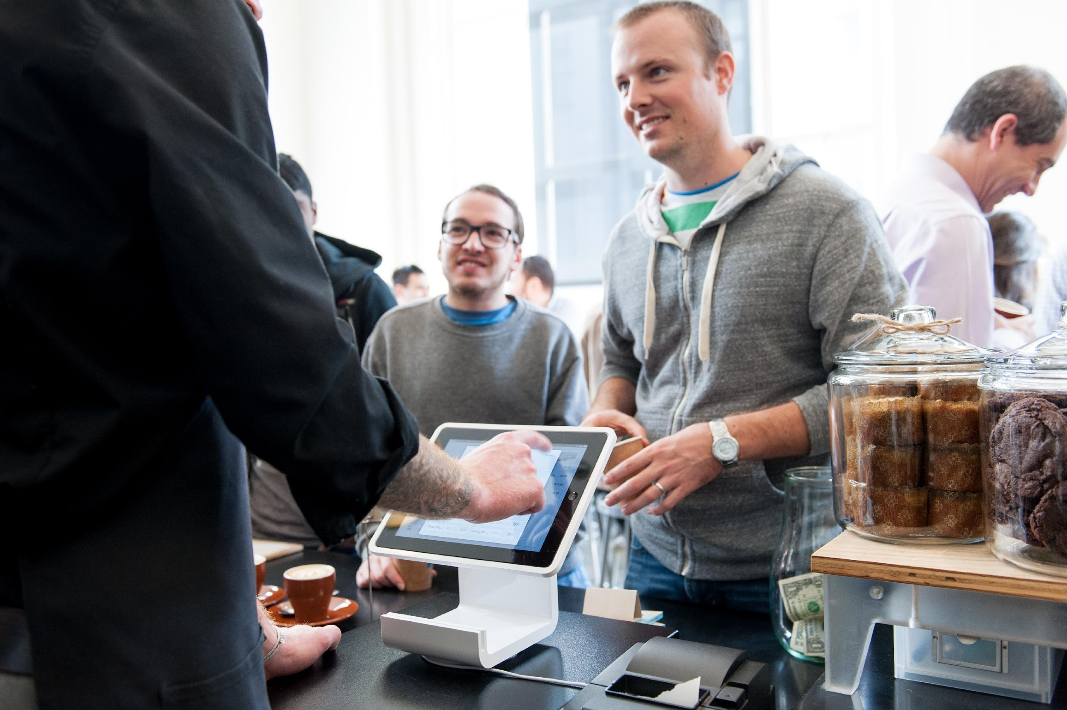




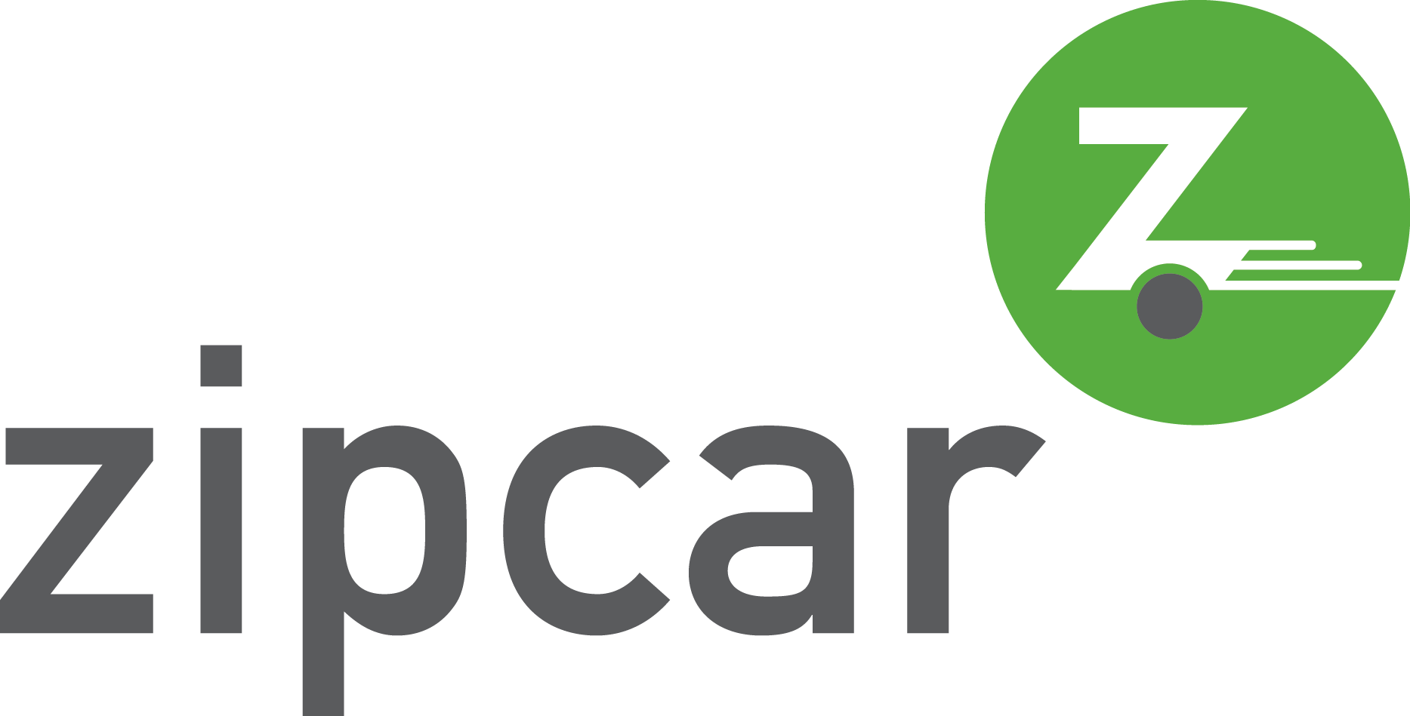


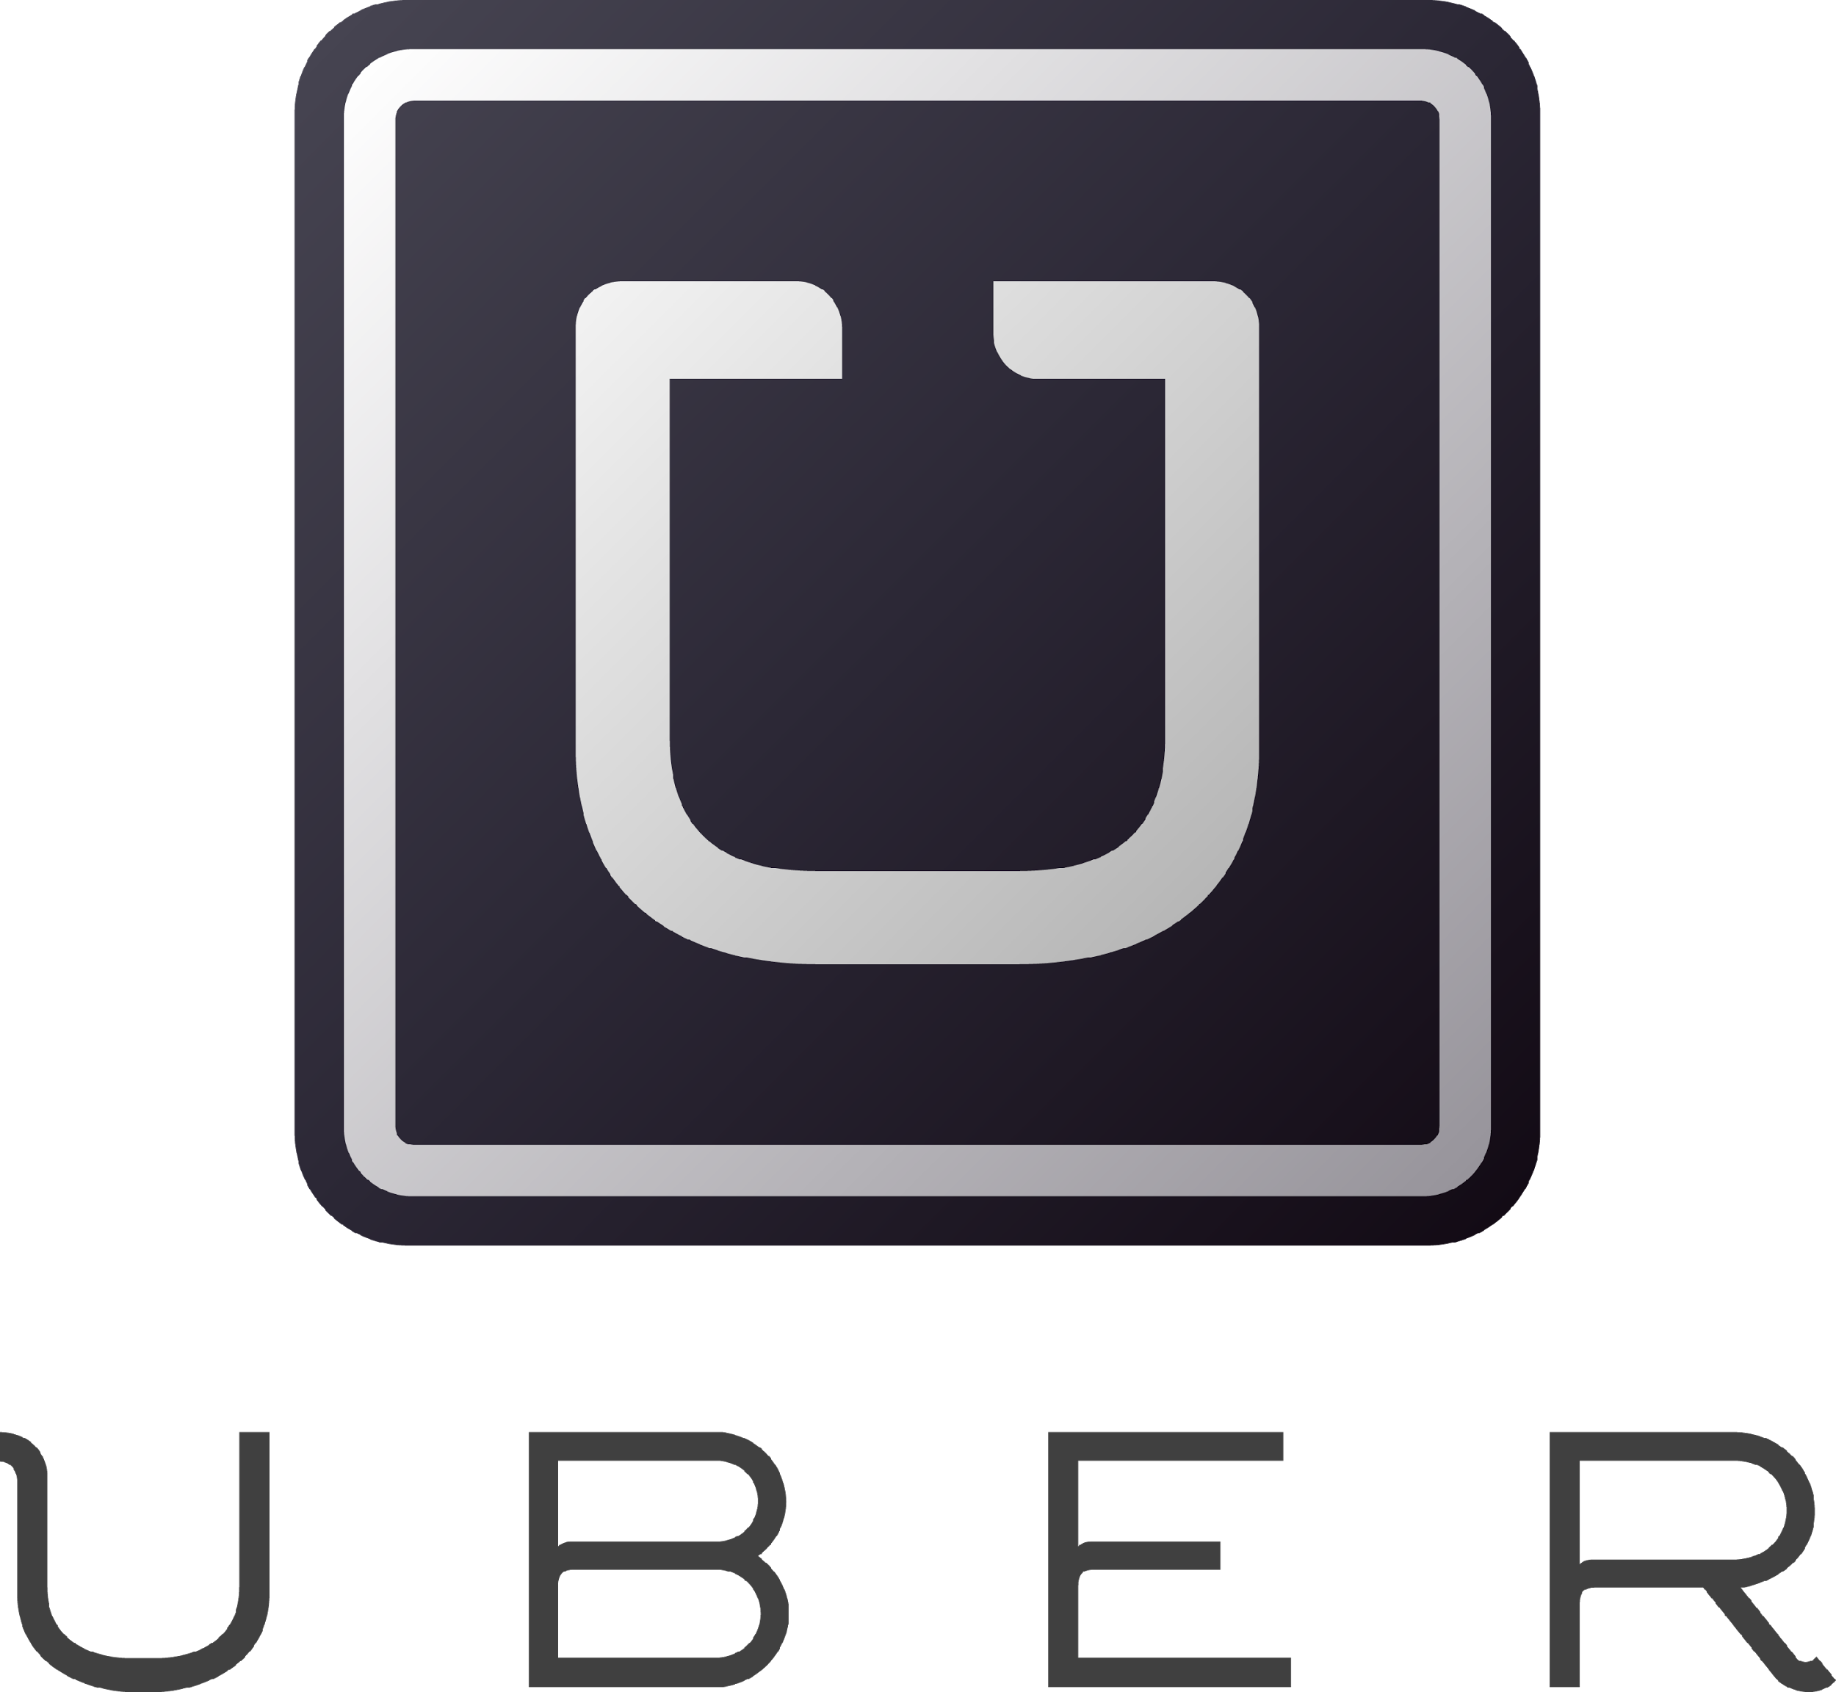
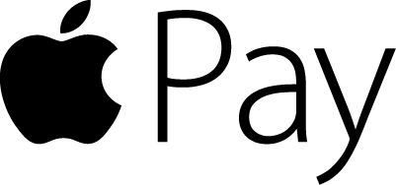
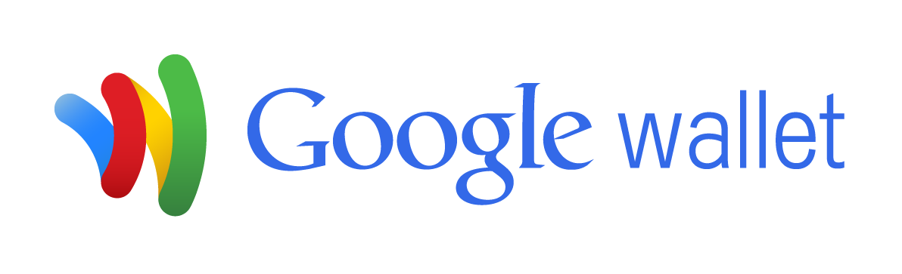

New Age of Digital Transformation
COMPETING ON
Product
Business Model
Customer Experience
Notes:
Over the last decade or so, a few really great companies
Took advantage of the availability of cheap cloud computing and
Established patterns for
application architecture and
operation models that
placed an emphasis on
delivery and
speed to market of software.
They were pioneers using software to come up w/ new business models and provide new and interesting user experiences.
Most enterprises were not really not a part of this movement and a couple of years ago only a handful were going down this path. But now we’re seeing …
--------------------------EXPLANATION IN CASE OF QUESTIONS------------------------
Tesla, Square and Facebook made new products addressing a new need or with improved alternatives to existing technologies.
Zipcar, wallet and Apple itunes changed how customers rent cars, consume movies, and consume music.
New Yorkers swap awful taxi tales like they're war stories. Uber changed that whole experience by rewarding good driver behavior via a customer rating system.
Apple pay is integrated with several retail rewards programs. Now we don’t need to carry the different loyalty cards around in our fat wallets. We don’t even need to reach and even open the wallet. Most people already have their iphones and iwatch in their hands all the time.

Slide 3
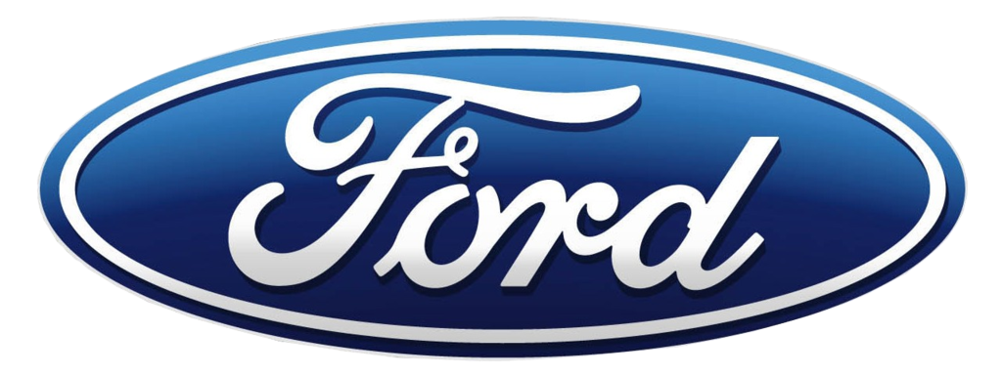
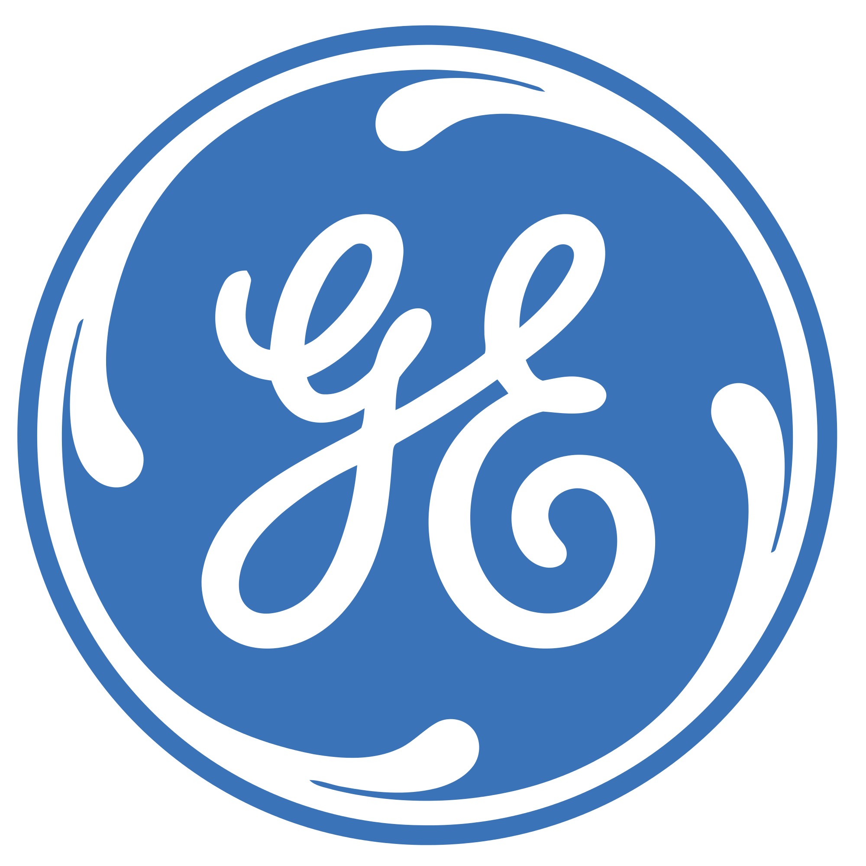


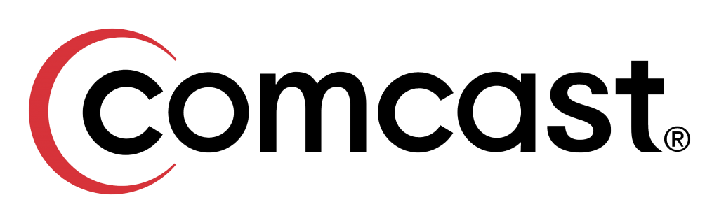
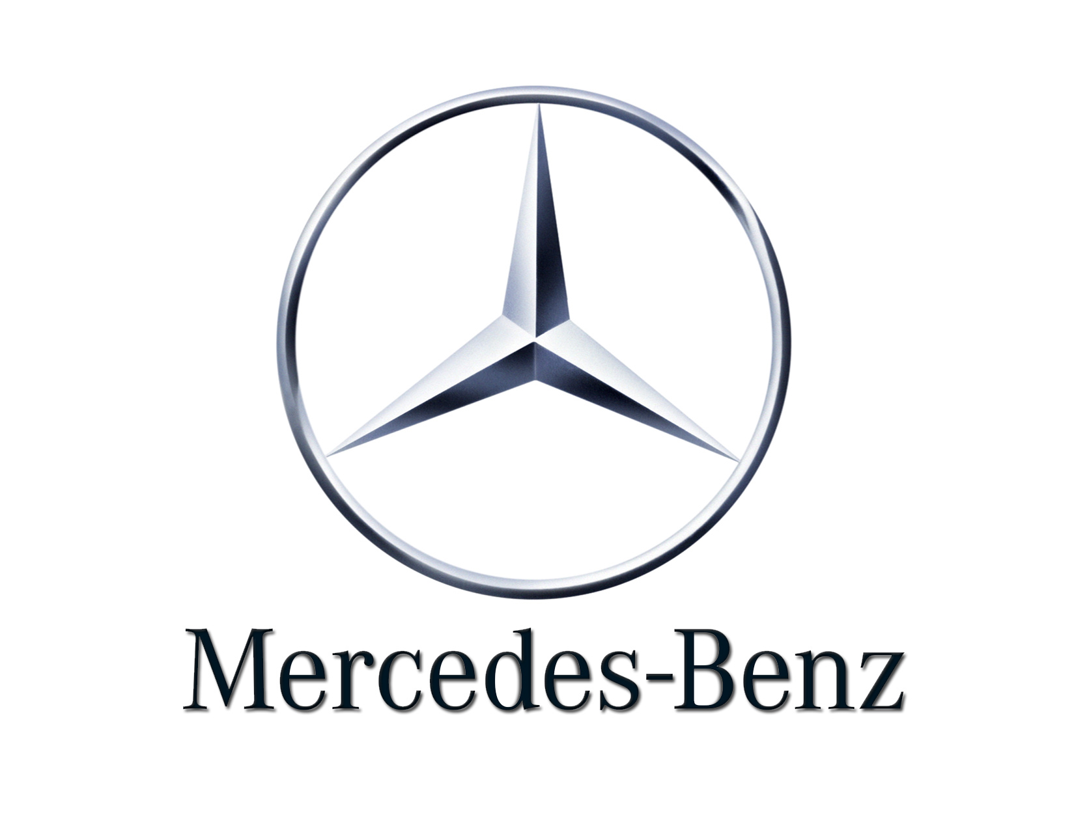
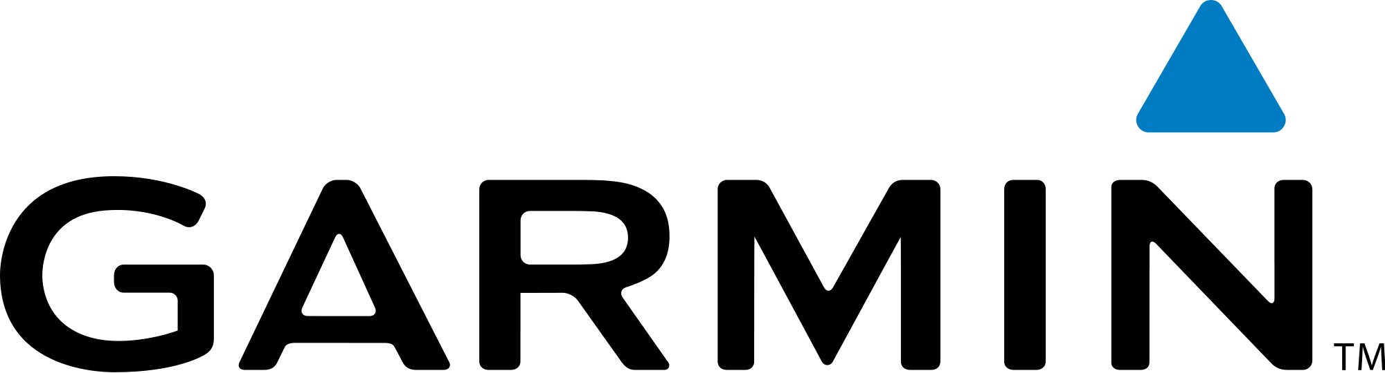
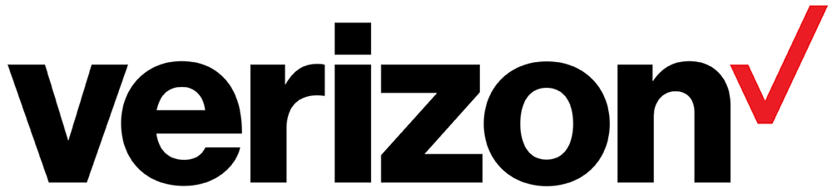
New age of Digital Transformation
Enterprises operating at startup speeds
Exploratory Questions:
Executive mandates/goals?
Is TTM something they are concerned about?
What is their Digital strategy?
Who leads it (business & Dev sponsor)?
Notes:
We are now entering a new era of digital transformation where enterprise IT in 100 year old companies in every major industry is gearing up and starting to deliver software at startup speeds

Slide 4
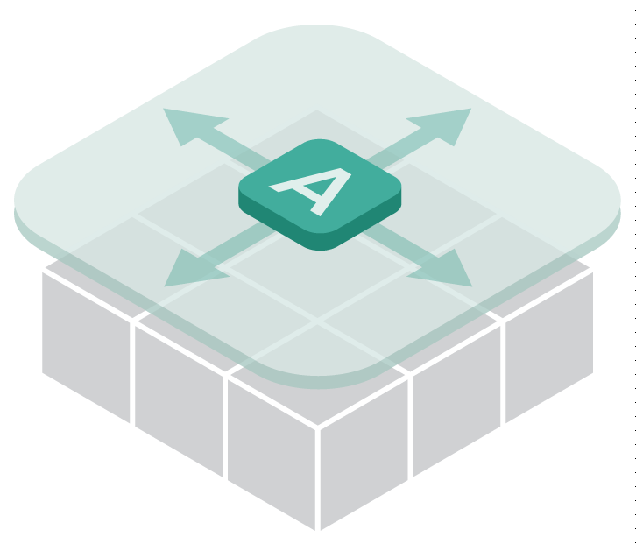
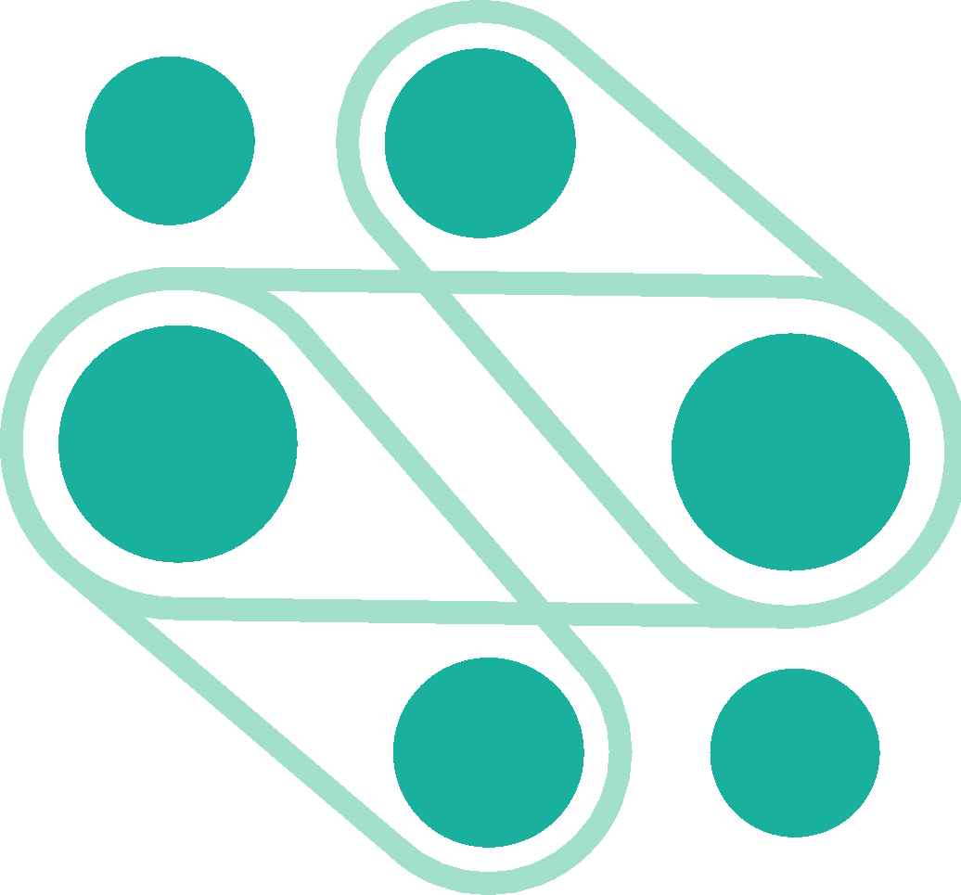
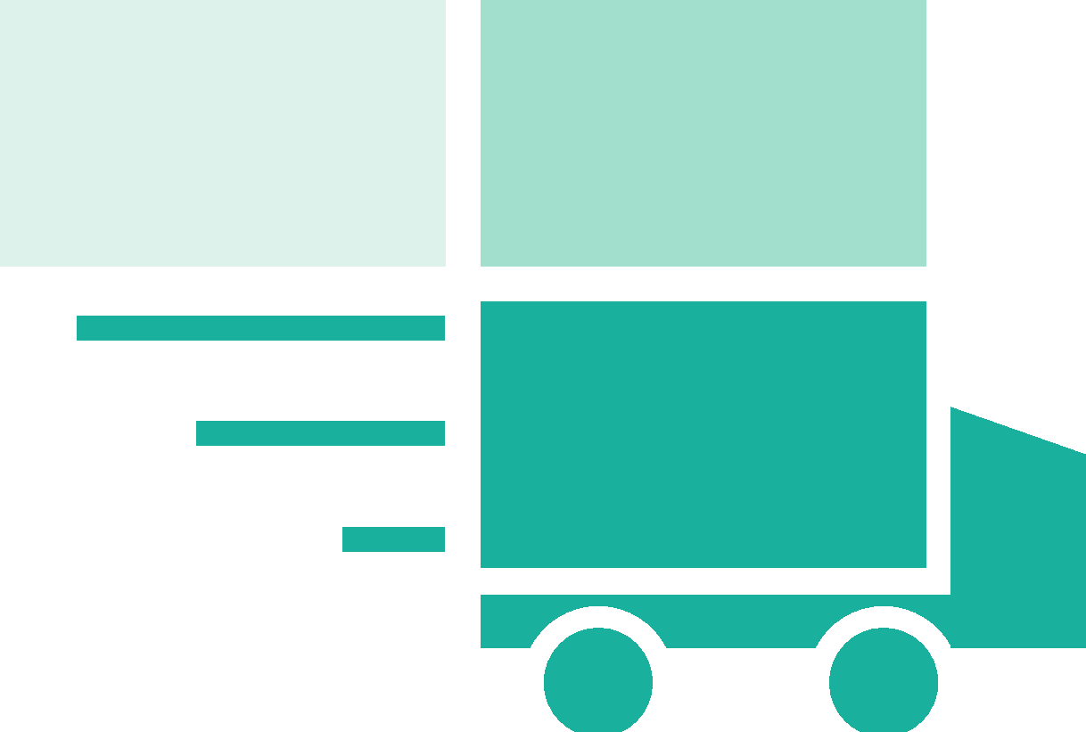

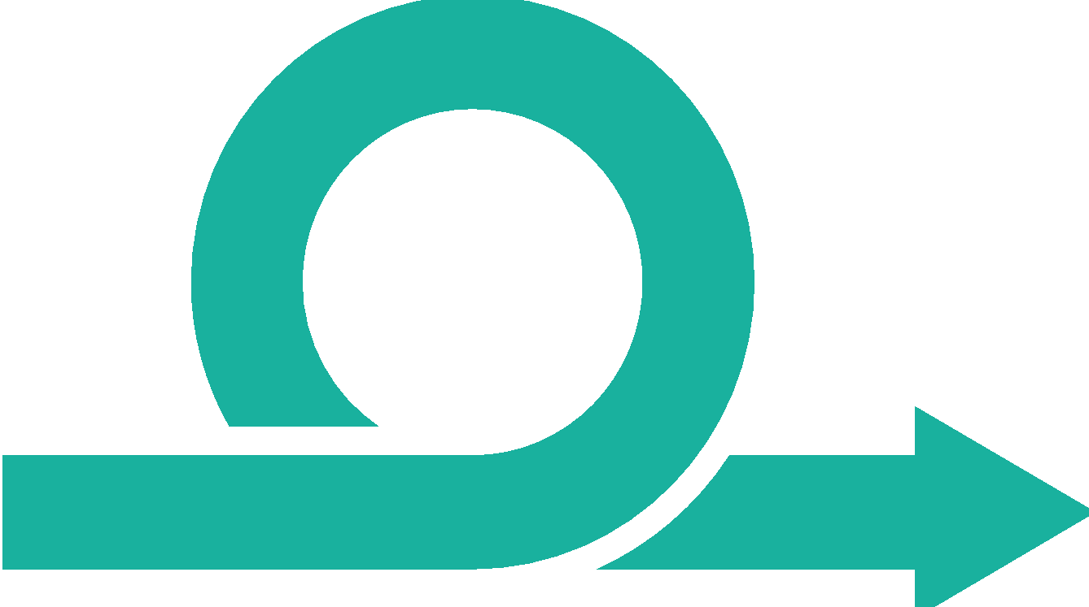
Changing Model for Application Delivery
Abstraction Layer
Architecture
Development
Deployment
“Day 2” Ops
Monolithic App
Linear / Sequential
App Server on Machine
Sparingly at designated times
Many tools, ad hoc automation
Microservices / Composite app
Short cycles, test driven, iterative
App on “disposable” infrastructure
Ready for prod at any time
Manage services, not servers
Notes:
How are they transforming?
These companies have started to close the gap in the changes that have occurred in building, deploying, and running their applications. What are these changes?
The Application deployment from before and what most people are familiar with:
Features were planned months in advance and tightly coupled as monolithic apps with intricate roadmap dependencies across the app components
Development process was linear, where months of design and planning phases lead to a long construction phase
This app was then deployed onto physical machines or infrastructure abstractions like VMs, keeping in mind app dependencies and configurations.
Once the app is deployed, Ops teams were then expected to manage these systems by
Adding on additional services for metrics, monitoring, orchestration
There was a designated time window in which the app was deployed or updated because this may involve restarting the whole server.
Once the app is deployed, they take on the non trivial engineering task of doing whatever is necessary to make the apps secure, patchable, and resilient to infrastructure failures (what we call we call Day 2 Ops)
With this sequential process, disjoint and partial automation - concept to code takes several months and each deploy was a risky event
What about Application delivery today:
The application is a loosely coupled composition of services where each service has its own independent software cycle. More people are shifting to microservices because it's an organizational optimization. It gives development teams flexibility to work on the pieces that are changing at their own pace and just ship them w/o a bunch of synchronization.
<click>Software development now is iterative and incremental with short, but frequent development cycles injected with constant customer feedback
<click> the primary abstraction layer is raised above infrastructure constructs. Rather than using API to create virtual infrastructure, applying various forms of configuration management and automation to enable our applications and supporting services, we are now using abstractions that allow us to think in terms of just applications and backing services. This lets us treat the underlying infrastructure as “disposable” because the entire stack from the app down to the OS is being version controlled and can be duplicated or reversed easily.
<click>The risk to production systems is reduced and the strong separation between Dev and Ops teams changes to one of organized collaboration, where they get code to staging and production several times a day, distribute deployment risk across many smaller releases.
<click>And once your app is deployed, the operational concerns of Patching, updating, and change management rely on automated orchestration of infra that was previously hand crafted. Ops is no longer managing servers, you’re managing services.

Slide 5
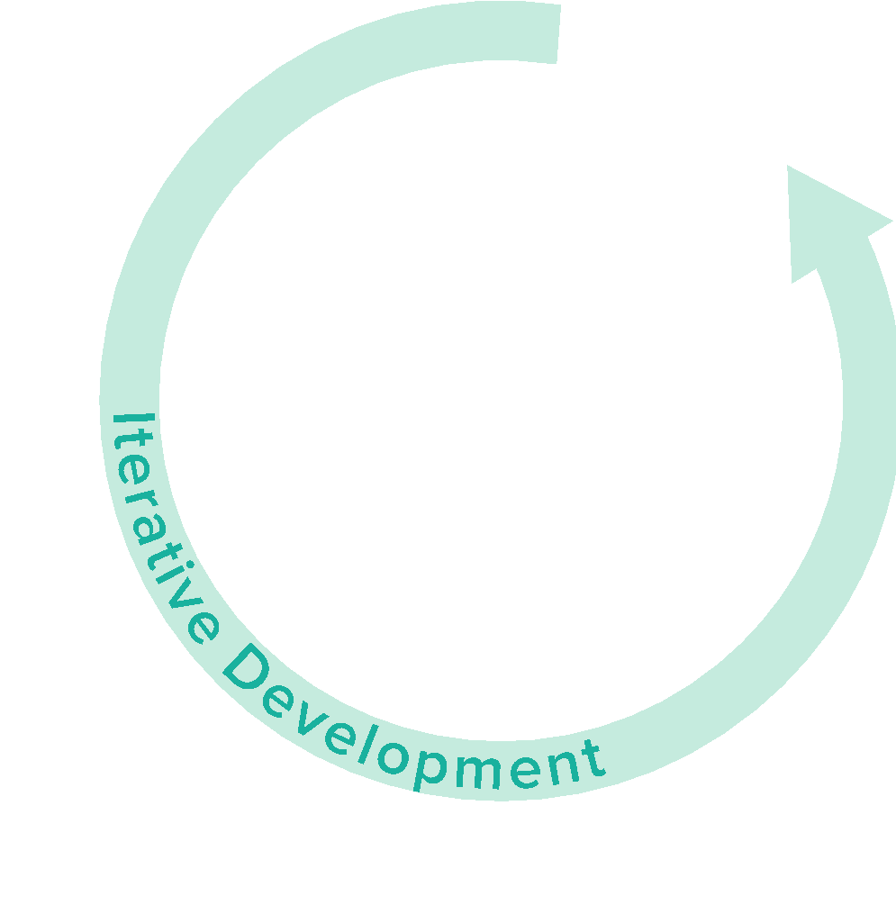
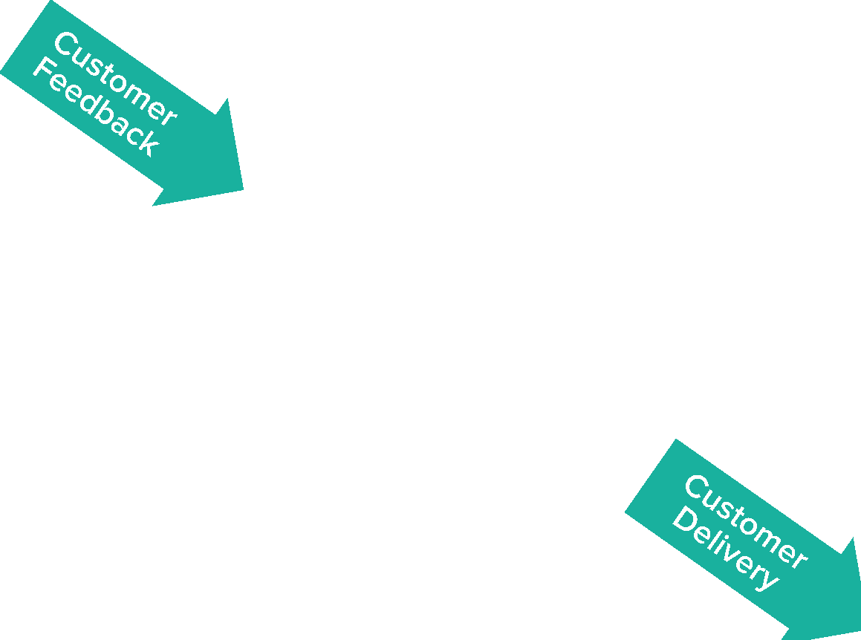
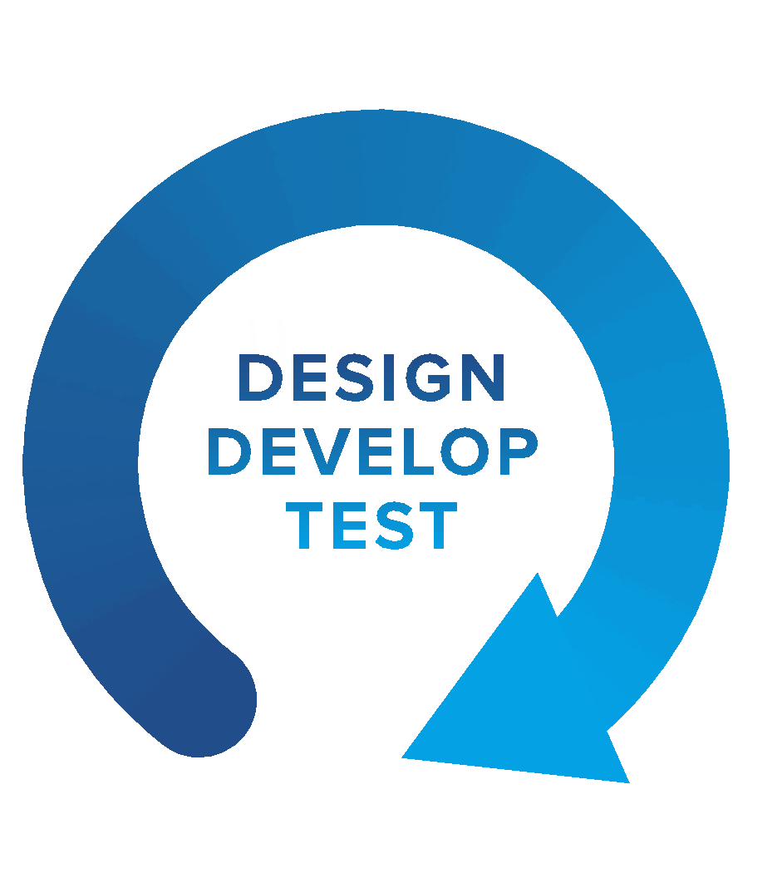
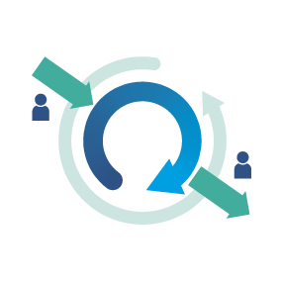

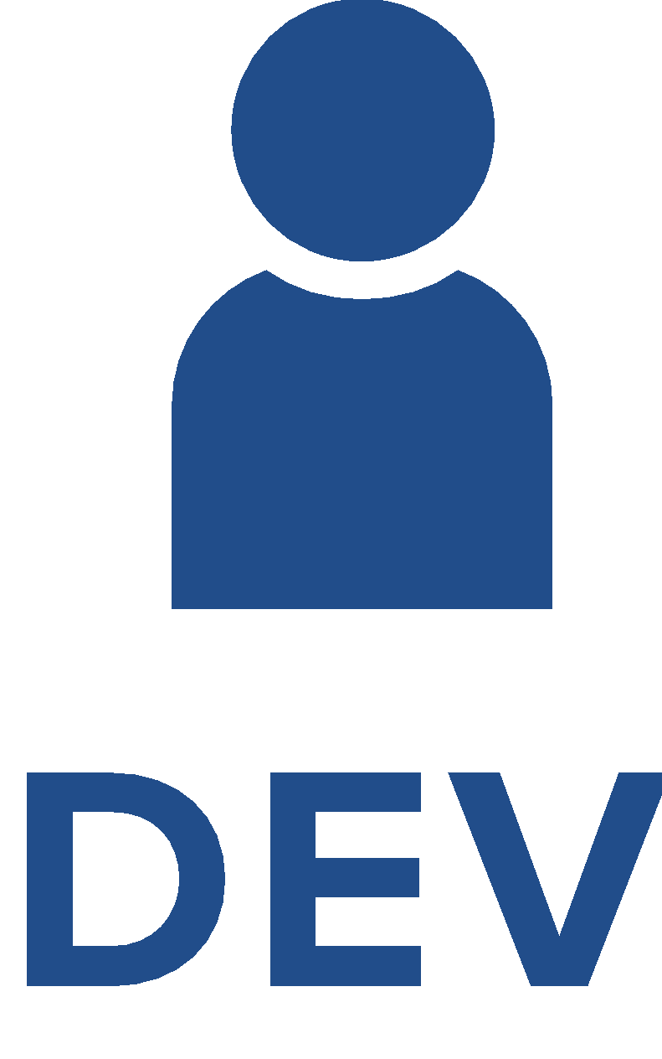
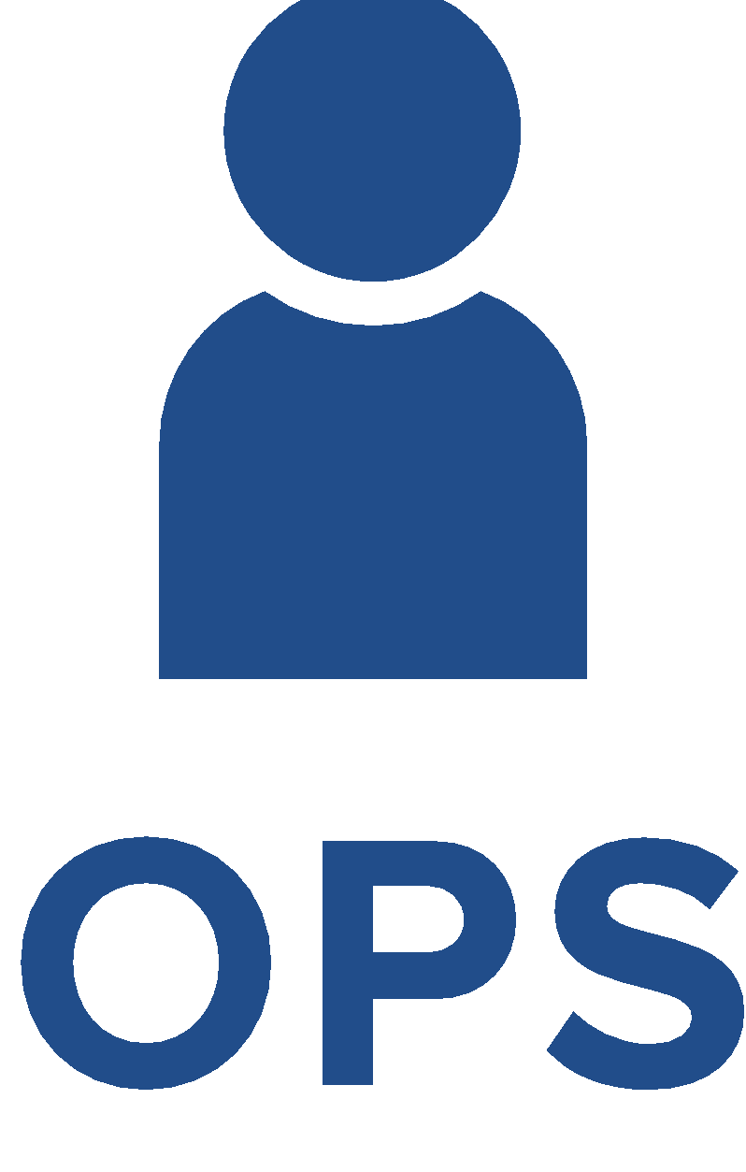

Rise of the Cloud Natives
Microservices
Microservices
Exploratory Questions:
Can they self assess their Devops maturity?
[[ Filter for “waterscrumfall” ]]
Anyone read Phoenix project?
Release #1
Release #2
An idea in the morning can ship by evening
Notes:
<Image is an animation>
This comprehensive shift in the model for App Delivery is what the industry is calling Cloud Native. Cloud Native is an advanced combination of devops, microservices and continuous delivery practiced with the goal of shipping more resilient software, faster.
To efficiently handle the operational impact of the cloud native delivery models, the technology to support the practices becomes the critical piece. More and more operational decision making and activity that required human intervention is being programmatically driven into the platform.
The platform
Helps teams adopt the architectural and operational changes required to be shipping functionality continuously (purple)
Its also a DevOps culture enabler. CNP makes doing the right thing the easy thing, repeatedly and consistently (gray + straight arrows)
It becomes the natural framework/contract between the teams (2 people), the app, the runtime & infrastructure facilitating the shared tools, processes, vocabulary that simplify collaboration between Dev and Ops (DevOps)
So that an idea in the morning can be in the product by evening

Slide 6




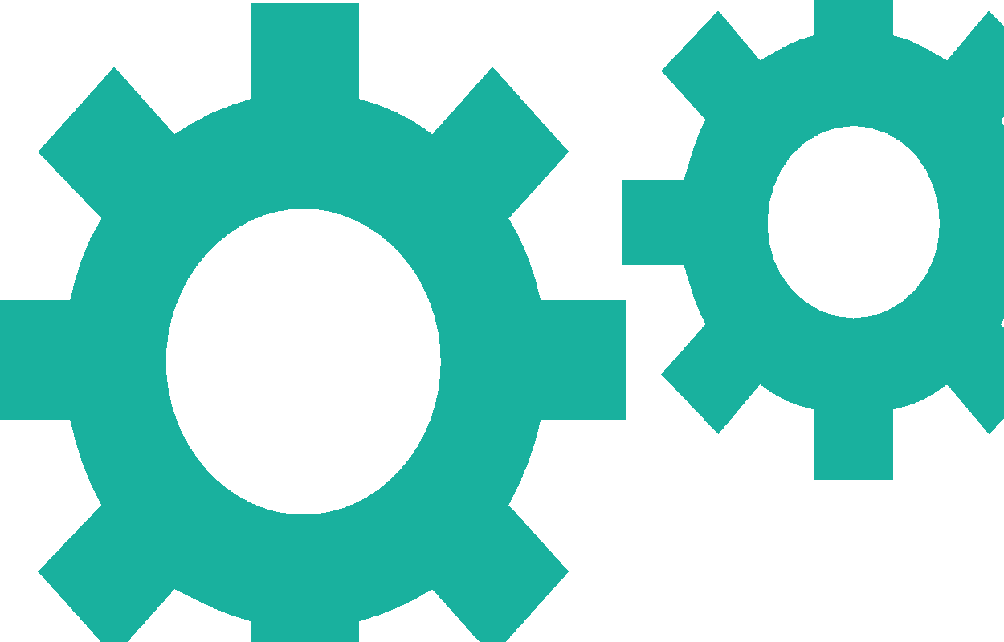
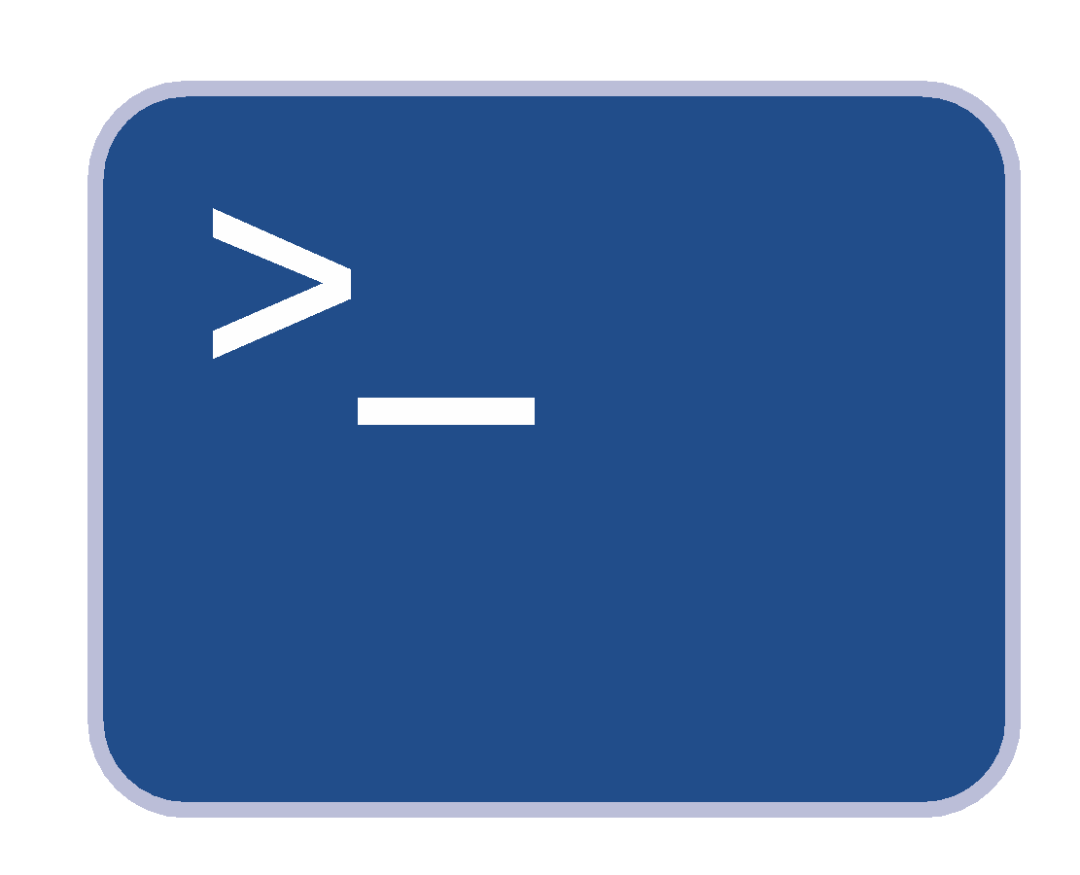
Typical Platform Evolution
New Reality
Built some automation and containers
Scripting
Notes:
The problem is that Ops is increasingly getting left to navigate a changing world sometimes still adhering to primitive processes like ITIL. Most of ITIL was established within the context of a tool set that deliberately limits changes. In today’s context, that puts the breaks on any business value oriented innovation coming from the IT organization.
One of our customers told us the story of how their Developers built microservices and sent it to Ops for deployment. At Ops and they basically just put it back together and deployed it as a monolith because their systems were so hard to change.
Another customer told us, that software remained misconfigured or Unpatched for long periods of time in their company. Its sounds odd, but the delays were actually due to well intentioned, but rigid processes that were set up to protect the environment, and these, ironically allowed the threat to persist in the environment for a long time even after it was detected.
Successful internet companies have actually optimized for the opposite. They make it as easy as possible to iterate and change to support building great software.
A lot of our customers that we’ve worked with have a platform evolution that looks like this
First things may start out mostly manual, so they automate by scripting.
Then scripting becomes too complex. Then they bring in server config management like Chef recipes/puppet manifest. Pretty soon they are investing a lot in designing for servers
Some others were experimenting with containers and shifting to microservices.
But Microservices imply a much greater operational burden because it increases the number of “things” that need deployment. Even for Ops teams that have made great strides in infrastructure automation – if they thought building automation and managing the lifecycle of one monolithic app is difficult, time consuming & complex, THEN a composite application with, say, 4 microservices that will each have their own lifecycles – we are talking a workload and expense for Ops that is now at least 4x.
Traditional means of building software, managing infrastructure aren’t going to work. Application delivery teams including Ops need to go beyond superficial fixes, and address the culture, processes and technologies that are “frozen” in the enterprise below the surface.

Slide 7


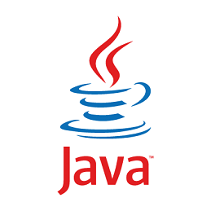
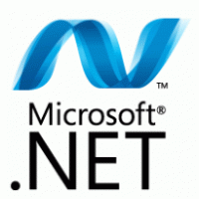
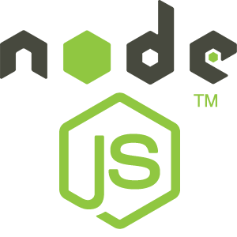
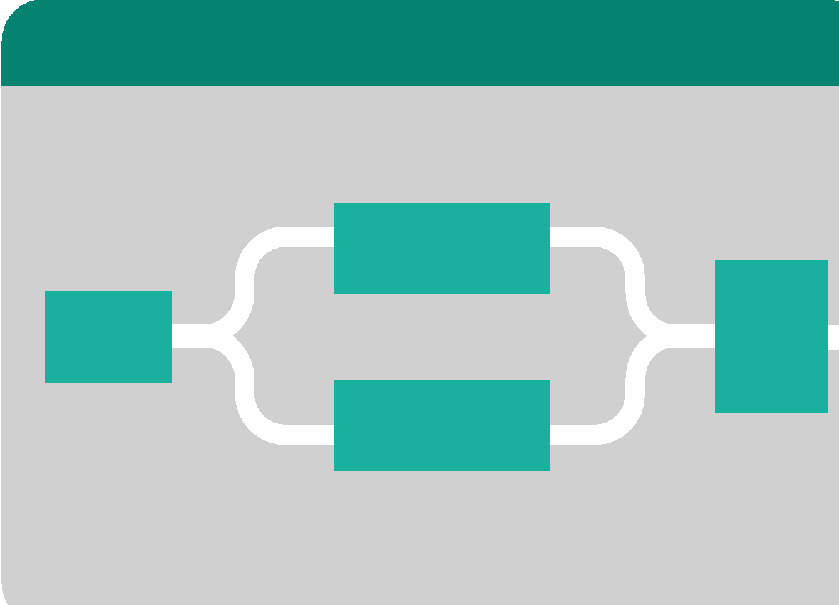

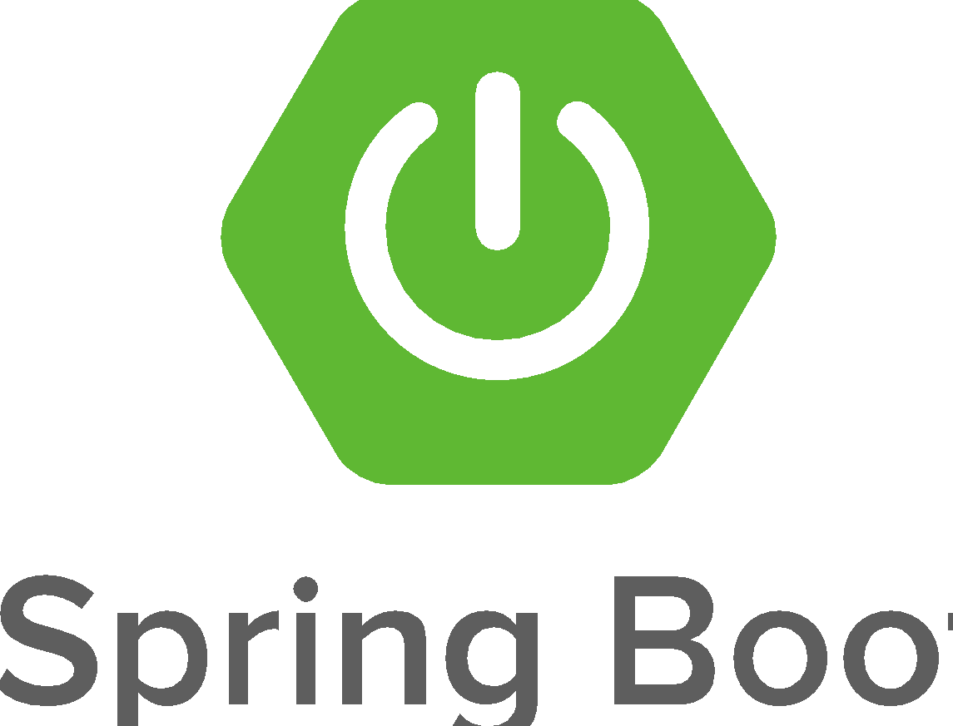
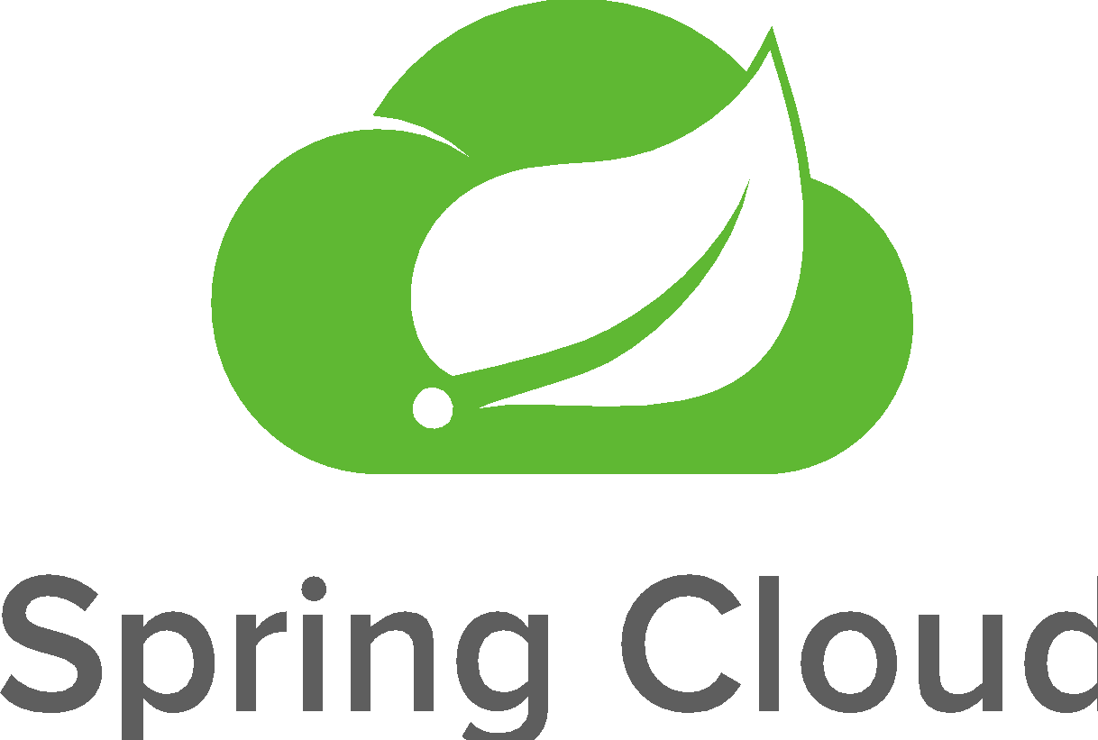



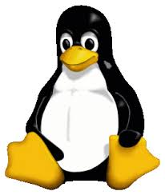
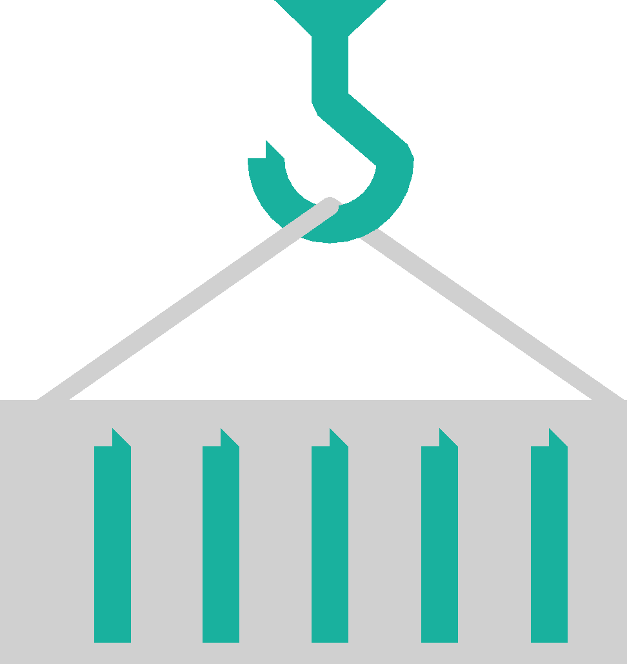
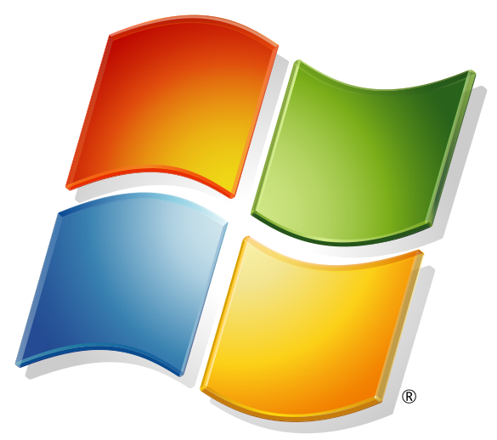
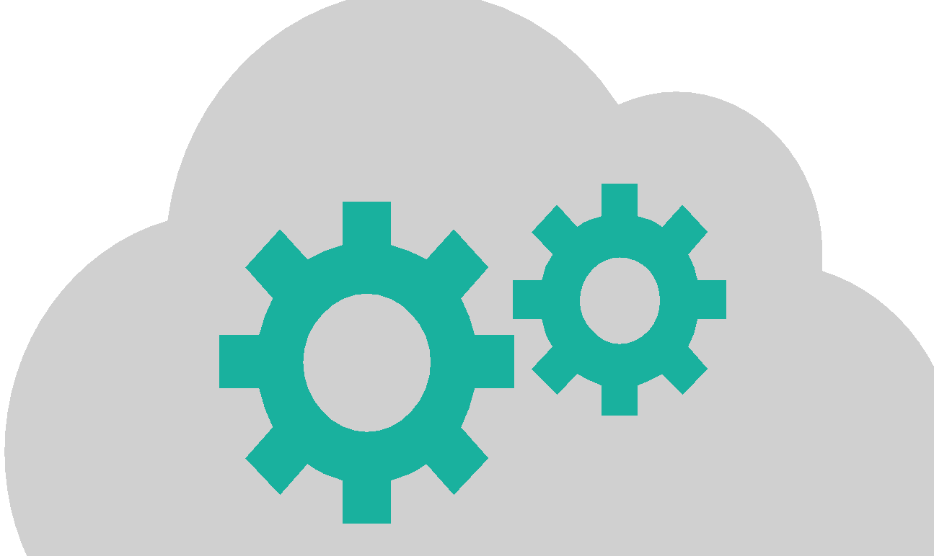
DEVELOPMENT
OPERATIONS
Multiple
Languages
App Deployment
& Management
CI/CD Tools,
ID, Security
Microservices
Support
Health, Metrics,
Patching
Availability
Services
Marketplace
Native
User Provided
Partner
Visibility &
Administration
Apps & Platform
Dashboards
Exploratory Questions:
What are the Ops team goals?
Main priorities that the team is working on?
Is multi cloud of interest?
Any PaaS/cloud platforms being used/evaluated today?
Operating
System
Container Orchestration
Cloud API
Notes:
Pivotal’s vision is to provide a full solution - a platform that allows agile teams to iterate, incorporating the best-of-breed technologies in the industry and best-practices in software engineering and release management.
The PCF platform allows Ops team to
Radically Improve Developer Velocity by getting them the right tools and leveraging existing expertise. We have
Support for many langs
Optimized for Cloud Native applications so developers can quickly stand up microservices, Includes battle-tested Netflix OSS integrations
Easy access to Services
Natively managed services like SSO, MySQL, partner services like AppDynamics, New Relic for monitoring, user provided services like Oracle DB, so enterprises can leverage the data they already have
Purpose built for Day 2 Ops.
Everything to deploy app is available. CI/CD tools, authentication
Once its deployed, everything is there to manage the availability of the app like metrics, health management, scaling etc.
Dashboards for holistic view across apps and Ops
World class container orchestration with zero human intervention in individual machines through app lifecycle
You get industry standard Linux containers, optimized for speed. OS management for Linux stacks and support Windows stack for .NET applications.
Built around Multicloud primitives, no cloud specific features.
We’ve seen customers struggle with piecing together the various tools themselves which can be
error prone and inconsistent.
because the linkages between the various tools is done manually and each product represents its own source of truth. Ops teams are unnecessarily stretched thin managing the individual pieces.
A more automated solution - one that stretches from the infrastructure all the way to the application framework, rather than ad-hoc automation
An opinionated platform that imposes strict contracts between it and the infrastructure layer, and between itself and the applications and services it supports ,
Is essential so your teams are focused on what brings most value to the company.

Slide 8
DEVELOPMENT
OPERATIONS
Multiple
Languages
App Deployment
& Management
CI/CD Tools,
ID, Security
Microservices
Support
Health, Metrics
Patching
Availability
Services
Marketplace
Native
User Provided
Partner
Visibility &
Administration
Apps & Platform
Dashboards
Exploratory Questions:
Ask the VP if they agree with value line and their view of their world is.
Ask them what parts of their job is most visible to the outside & external teams
What aspects of their job are important to them?
VALUE LINE
Operating
System
Container Orchestration
Cloud API
Notes:
The PCF platform provides integration and automation on both sides of this line we’re calling the value line to help IT ops focus their resources where they can maximize the strategic impact of their org.
From Our POV: Everything on top of value line, that is YOUR apps and how quickly YOU can get them out there is what brings maximum value to your business.
You are Improving Developer Velocity and business satisfaction, {point top left}
You benefit from better Uptime, improved MTTR, improved admin-server ratio and reduce the impact of breakages. These are the things that are most visible to the business and external teams {point top right}
{point below line}
And down here, below the line is where we have spent a lot of time on automation so you don’t have to. Everything below is very important, but ultimately non-differentiating to you and your business. No CEO ever said “great job managing those Operating systems”.
Unfortunately, Most of the Ops teams live down here, stuck, trying to build that automation on a per app and per BU basis (below the line). But the real value is actually up here and here and ops teams are making herculean efforts to make a mark here (top of line). Do you agree ? (ask the VP if they agree and see if how they view the world)

Slide 9
DEVELOPMENT
OPERATIONS
Multiple
Languages
App Deployment
& Management
CI/CD Tools,
ID, Security
Microservices
Support
Health, Metrics,
Patching
Availability
Services
Marketplace
Native
User Provided
Partner
Visibility &
Administration
Apps & Platform
Dashboards
Operating
System
Container Orchestration
Cloud API
Notes:
Now Lets take a closer look at the platform starting with how Ops can helps support Developer Velocity

Slide 10
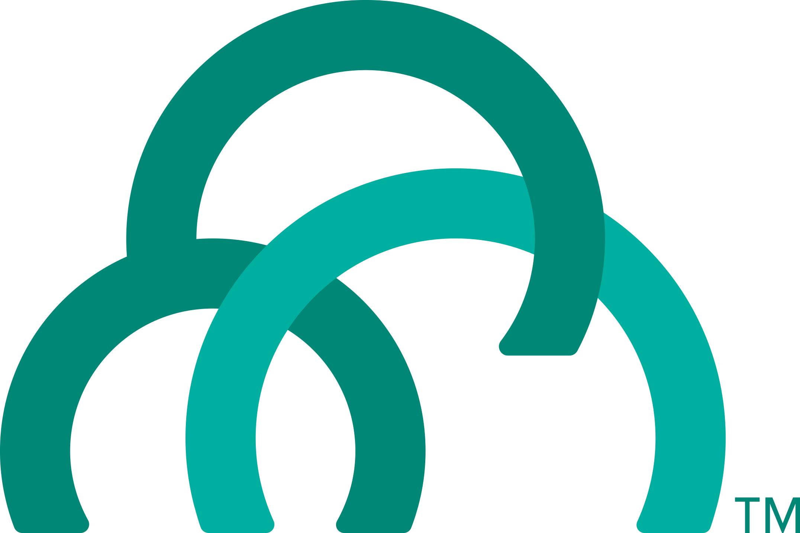

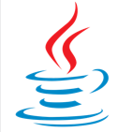
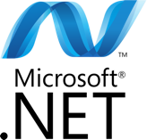


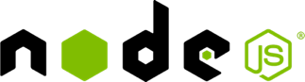
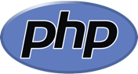



Developer Self Service Provisioning
Flexibility with control
>cf
Push App
http://
more…
Push your app and it just works…no “snowflakes”, no waiting.
Notes:
Because the Platform supports a number of languages and frameworks. Ops no longer prepares special app stacks and configurations
With just 1 platform, ops can easily provide devs the flexibility to use the languages of choice, and the same experience across all of them while greatly reducing IT complexity.
Environments can be made immediately available through self service with the right policies applied the second developers need it.
Devs simply push their app “cf push” either via command line or IDE. The platform detects what kind of app it is, provisions the resources and runs your app in a container - no waiting. Those resources like embedded webserver, the app configurations, the service connections that the app is bound to, are all bundled into what we call a “buildpack”. Ops teams can curate and customize the buildpacks to ensure developers are on the most secure and up to date versions.
<optional: if you know the devs want to use Docker>
PCF also runs Docker images. Docker is basically a container format and is “packaging and a subystem” concern. Docker by itself is not a platform and has limited value on its own. If Developers want to use Docker, they can now leverage the built in Pivotal Cloud Foundry platform capabilities that we will talk about shortly to run Docker images. This doesn’t mean that developers should pull together a random set of Docker images and magically get orchestration and management. We see developers building Docker images from their continuous integration processes. From our POV its just about offering an alternate mechanism for deploying code that’s independent of container formats so that developers continue to have flexibility.

Slide 11

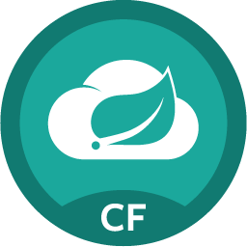
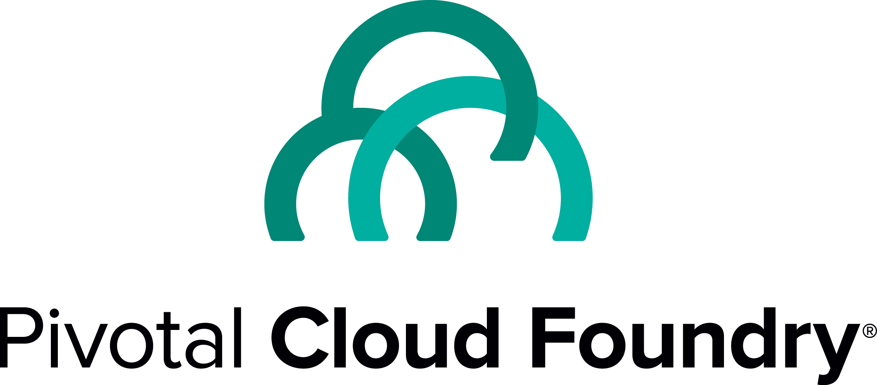
Complete Microservices Framework
Spring Boot
Spring Cloud
Services
Notes:
PCF delivers the complete Microservices framework on the platform via Spring Boot and Cloud.
Spring boot is a great scaffolding for developers to churn out applications. But microservices is not just a developer concern.
If all of the operational tasks necessary run microservices are to function correctly, that’s non trivial.
Spring Cloud Services based on the Netflix OSS components - provides solutions to some of the more commonly encountered challenges and operational overheads when building distributed systems with microservices.
How does one know which services exist? There is service registry.
How does one keep them highly available and mitigate cascading service failures? There is Circuit breaker.
How do you keep configuration centralized and uniform across scaled out services? There’s Configuration manager.
We have distributed sessions to store web session data.
In PCF these capabilities are available from day-1 because it is pre-wired into the platfrom. Its purpose built for distributed, horizontally scalable application architectures. There are lots of platforms out there, but to date, none of them are including these services as part of the platform package.

Slide 12
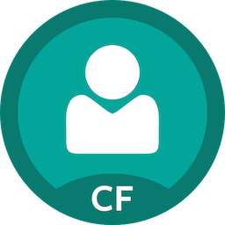
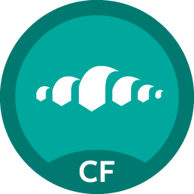
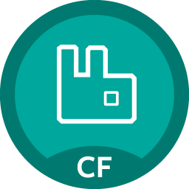

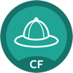
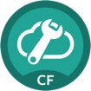
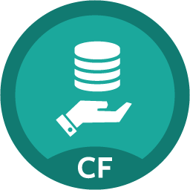
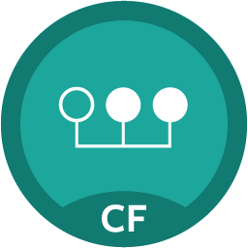
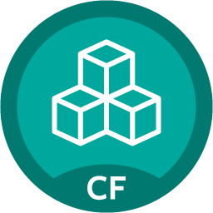
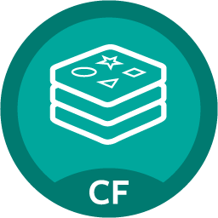


Services prepackaged for simple consumption
Services Marketplace
Easy accessibility through Marketplace
Instant Provisioning and full lifecycle managed
Bind to apps through easy to use interface
Common access control and audit trails across services
Single Sign-On
Jenkins Enterprise
RabbitMQ
Circuit Breaker
Service Directory
Config Server
MySQL
Session state caching
GemFire
Redis
DataStax Cassandra
AND MORE
Notes:
Services are pre-packaged for simple consumption on the platform
Devs get Easy access to supporting services for their apps
Services can be selected from many different offerings and consumed through our built in marketplace that can be managed and curated by Ops.
Single Sign On, Continuous integration service, Spring Cloud services, data services, partner services, etc.
The Provisioning, the full lifecycle and the Availability of the services is all managed through PCF
And operators have Common access control and audit trails across the breadth of services
If the apps need access to existing data services that are not part of the platform like e.g. Oracle DB, that’s possible as well.

Slide 13
DEVELOPMENT
OPERATIONS
Multiple
Languages
App Deployment
& Management
CI/CD Tools,
ID, Security
Microservices
Support
Health, Metrics,
Patching
Availability
Services
Marketplace
Native
User Provided
Partner
Visibility &
Administration
Apps & Platform
Dashboards
Operating
System
Container Orchestration
Cloud API
13
Notes:
So far we have covered how Ops can easily provide the developers what they need to build the applications, let’s talk about deployment and beyond.

Slide 14




Comprehensive application lifecycle management
Commit Code Change
Automate Build & Test
(Unit Test, Static Code Analysis)
Store Binaries & Build Artifacts
Deploy, UAT, Stage App
Zero Downtime Upgrade to Production
Exploratory Questions:
What tools are your teams using today?
Build Pipeline Operations
Tool Chain
Gitlab
Jenkins
Artifactory
Pivotal Cloud Foundry
Notes:
Continuous delivery is key to iterative development process and CI/CD tools provide the framework for delivery process with transparency between Dev and Ops.
First platform built assuming CD as the prime directive. The platform integrates tools and automates processes for full app lifecycle from testing to builds and deployment
It provides a
consistent API to automate deployments,
standard tooling for all apps with
Commits from many teams rolling into production hosted env as fast as possible with safety
GitLab, Jenkins and Artifactory can also be installed on and managed by Pivotal Cloud Foundry, which makes it even quicker and easier to get these platforms up and running.
-------------------Notes on the partner and SCS products for in case of further discussion-------------------
Gitab - Source control product using GIT that includes git repository management, code reviews, issue tracking, wikis , etc. We provide a managed solution, including automated deployment, configuration, scaling & upgrade (via Ops Manager) with persisted data and configuration. Not required to be an expert in Git.
Jenkins - #1 CI tool, 8 years old. Includes the core open source Jenkins technology with advanced enterprise features developed by CloudBees. CB provides professional technical support for Jenkins and 1000+ open source community Jenkins plugins. One click install and scale w/ PCF Ops manager, integrated authentication with PCF UAA to provide single sign-on and support for role-based authentication and authorization
JFrog artifactory - Automate all aspects of artifact management using REST API. Powerful enterprise features and fine grained permissions. Advanced security and reliability features control access to artifacts, where they’re deployed and supports large load bursts with extremely high concurrency+data integrity. Can serve as internal & private docker registry access. Push button deployment , automated upgrades via PCF Ops Manager, with persisted data and configuration. Not required to be an expert in JFrog Artifactory.

Slide 15
Accelerating the velocity of each iteration
Spring Cloud Config
Dev
UAT
Staging
Production
- Dev, Test, Staging and Production on the same platform
- Bit for bit consistent environments
- Logical groupings of user access controls
Notes:
Development, Test, QA and Production are all on the same platform with bit for bit consistent environments that are just logical groupings of access control for the various roles.
Through env variables and through spring cloud config, environment specific configurations and external dependencies can be injected for each application instance to consistently and seamlessly move through each stage. This also ensures that all the apps are promoted with the same process. This is automatically enforced throughout the lifecycle into prod consistently (without having to write recipes and scripts). This really reduces breaks/bugs due to configuration drift. No more “but it works on my machine”.
-------------------Notes on the partner and SCS products for in case of further discussion-------------------
Spring Cloud Config - provides server and client-side support for externalized configuration in a distributed system. With the Config Server you have a central place to manage external properties for applications across all environments. The concepts on both client and server map identically to the SpringEnvironment and PropertySource abstractions, so they fit very well with Spring applications, but can be used with any application running in any language. As an application moves through the deployment pipeline from dev to test and into production you can manage the configuration between those environments and be certain that applications have everything they need to run when they migrate.

Slide 16







Everything to Deploy and Manage the App
1. Roles and Policy
5. Security and Isolation
6. Blue-Green deployment
2. Metrics
3. Log Aggregation
7. Scaling
4. Health management
Notes:
The previous generations of tools leave a lot of burden on operators. To minimize the number of handoffs and human effort Everything to manage the app is built in to the platform - all the pesky details of getting the app into prod, securing, patching and keeping it available.
PCF provides an abstraction layer that allow you to scale out with application containers as the unit (not the VMs). So…You will no longer need to know which VM or where your app container is running because PCF surfaces visibility at the app layer and not through infrastructure constructs like VMs. The instance of your app is the primitive that PCF uses.
Roles and Identity: Policy enforcement and role based access to platform resources are all integrated and can be set. Using our SSO service, operator overhead of enabling security for apps is drastically reduced because it’s a 1 time setup instead of an app by app effort.
Metrics, log aggregation and health management needed for the resiliency
Instant horizontal scaling; autoscale
Dynamic load balancing and routing: support for instant horizontal scaling
Fast, no downtime updates of your app w/ blue-green deployments (scroll to see optional notes section below)
Security: Security is not a once-and-done endeavor. Treatment of security is broad and ubiquitous to the entire platform. With Pivotal Cloud Foundry, every VM in your datacenter can be repaved automatically from a known good state every few hours. Vulnerable Operating Systems and application stacks can be repaired consistently within just hours of the patch becoming available. And this can be done without application downtime. We could spend a whole session on just this one topic.
<optional: If someone needs an explanation of blue green>
Blue-green deployment is a release technique that reduces downtime and risk by running two identical production environments called Blue and Green.
At any time, only one of the environments is live, with the live environment serving all production traffic (e.g blue). And the updates are applied to the the one that is not live (green).
With a single command, your incoming test traffic to “green” and if that works, eventually your live traffic from blue will be switched to green without the end user experiencing downtime due to the application update.
Once 100% traffic is on green, you can take away blue or keep it around for a bit in case you need to rollback.

Slide 17

Fast-feedback Monitoring Capabilities
Integrated, near real-time view of key app, services & platform metrics
Devs & Ops have shared understanding of system health / availability
No embedded agent
Simply select an app to watch streaming data
Notes:
The platform also helps keep tabs on the running system by providing a near real time, integrated view of the system state. Its surfaces important information on
1) Network metrics
2) Container metrics
3) And App events like when it was created, updated, stopped or crashed
Developers & Operators share an understanding of the app and platform health with the key information that’s needed for problem detection and analysis.

Slide 18


Comprehensive Visibility & Administration
Operations Manager
Applications Manager
Notes:
Consolidated management for Apps and Platform services through Apps Manager and Ops Manager dashboard is available.
Operations Manager is a web application that you use to deploy and manage a Pivotal Cloud Foundry environment on your cloud provider of choice. Its also how PCF products including the Elastic runtime and the services are installed, patched and upgraded as tiles in ops manager GUI. Its one of the ways in which you can monitor VM status and health of your overall PCF installation – like making modifications and scaling of resources that have been allocated to the different platform components. And many of these changes can be done while your apps are in flight.
Apps Manager is the GUI for managing the PCF Elastic Runtime Service and how the operators set the platform up for consumption by the development teams. Elastic runtime can be logically divided by Organizations and further into spaces with fixed quotas. Operators can also use these constructs to assign access to users without going at it on an app by app basis. Apps manager can be used to monitor applications logs, services and routes, set up access to Service Marketplace, increase or decrease the number of instances of an application, how much memory is allocated to it, the status of the application.
Between these two interfaces, operators have comprehensive visibility and administrative capability across the breath of applications, across organizations and across products and runtimes.

Slide 19
4 Levels of High Availability
1
2
3
4
App Instance Fail
Process Fail
VM Fail
Availability Zone Fail
Process
VM
VM
VM
VM
VM
VM
VM
VM
VM
VM
VM
VM
VM
Notes:
PCF was designed with the assumption that complex systems will develop inconsistencies over time. The platform is intelligent enough that it isn’t told what to do at every step, but its told the desired state of what it should be, and then it does the right things to make that be true. The constant checking, detection and remediation make sure that state always returns to consistency which can really have a positive impact on MTTR.
4 layers of Self healing built in to keep app available :
If an app instance fails, PCF restarts it in a new container
If a process fails PCF restarts, that is, failed cluster components are restarted which makes this a self healing system
If there is a problem detected in the VM, PCF kills that VM and spins up a new identical type of VM
And finally, PCF can be set up to distribute instances automatically across AZs. If an AZ is lost, App Instances keep running.

Slide 20
DEVELOPMENT
OPERATIONS
Multiple
Languages
App Deployment
& Management
CI/CD Tools,
ID, Security
Microservices
Support
Health, Metrics,
Patching
Availability
Services
Marketplace
Native
User Provided
Partner
Visibility &
Administration
Apps & Platform
Dashboards
Operating
System
Container Orchestration
Cloud API
Notes:
And finally, automation’s goal is to ship comprehensive cloud services not ad-hoc automation

Slide 21





Container Scheduler Handles Workloads
Notes:
Pivotal Elastic Runtime is actually one of the most mature linux container scheduling environments in the world.

Slide 22
Container Scheduler Handles Workloads
Dynamic load balancing
Notes:
The platform distributes new work as it arrives and uses a pretty sophisticated process. A sophisticated algorithm balances application processes over the virtual machines and an Auction determines which processes should be allocated to which VMs while optimizing for application availability and resilience.

Slide 23
Container Scheduler Handles Workloads
Dynamic load balancing
Remediation and rebalance of workloads
Notes:
The platform monitors the applications, and if any of them crash, they get restarted and rebalanced across available capacity.
<CLICK>And as mentioned before the platform attempts to revive the VMs. None of this requires human intervention. (animation that shows this)

Slide 24

Each Layer Upgradable with No Downtime
Application
C o n t a i n e r
Blue-Green deploy
App Runtime*
Exploratory Questions:
How do they patch and upgrade today?
Do they do blue green deployments?
Are there any penalties to downtime or SLAs they are trying to meet?
File system mapping
Canary style deploy
Linux host & kernel
* e.g. Embedded webserver, app configurations, JRE, agents for services packaged as buildpacks
Notes:
The dotted line you see is the marketecture for a container. With PCF, the platform operator has push button control of the full s/w stack.
The app itself can be updated using BG deploys (Explained below)
The App Runtimes can be updated the same way. We talked about buildpacks a little earlier in relation to how they automatically determine what runtime resources are called on by the platform to deploy the app.
The buildpacks that we provide with the platform are constantly updated by Pivotal with the latest security fixes
Applying a patch or upgrading a buildpack is done by the operator with a single command.
The changes are applied to the app instance at the next cf push.
The user traffic can then seamlessly transition to the new app instance using blue-green method as usual.
And finally, operating system patches and upgrades are applied via what we call rolling canary deploys that are done “in flight” across batches of VMs until the update has permeated the whole system.
{{Pivotal platform architects can extend the script and spend more time and detail on this image asking how their org reacts to CVEs like shell shock. They can go over in detail how we can update each layer w/o using this script}}
<optional: If someone needs an explanation of blue green>
Blue-green deployment is a release technique that reduces downtime and risk by running two identical production environments called Blue and Green.
At any time, only one of the environments is live, with the live environment serving all production traffic (e.g blue). And the updates are applied to the the one that is not live (green).
With a single command, your incoming test traffic to “green” and if that works, eventually your live traffic from blue will be switched to green without the end user experiencing downtime due to the application update.
Once 100% traffic is on green, you can take away blue or keep it around for a bit in case you need to rollback.
<optional: If someone needs an explanation of canary>
When performing updates, PCF does things in batches. It allows you to specify a small number of VMs in the first batch to change.
The first batch is called the canary. PCF redistributes the workloads in to others and runs the update.
If the canary batch fail to upgrade then the deployment/change is halted. Your remaining VMs are unaffected and workloads still running. Your canary VMs are left as they are - probably broken in some way - ready for you to diagnose and fix.
If the canaray passes, the updates rolls through. Each time a subset of VMs is taken and updated the same way until all are done.
The name comes from history. Miners carried caged canaries (birds) down into the mine tunnels with them. If dangerous gases such as carbon monoxide collected in the mine, the gases would kill the canary (which is anatomically very sensitive to poisons) before killing the miners, thus providing a warning to exit the tunnels immediately.
http://stackoverflow.com/questions/16047306/how-is-docker-different-from-a-normal-virtual-machine

Slide 25



Patch With Rolling Deploys
Notes:
This comes in pretty handy because there have been so many CVE’s lately. When the heartbleed virus hit, our customers took our patch and using canary deploys the fix ran itself across all the VMs under PCF in the data center. All they used was our GUI and 2 easy commands. And one of their engineers actually tweeted their experience where it took 2 people a few days to apply the fix, whereas if they had used traditional tools, it could taken up to 2 years to get it all.
And if devs were rolling their own Docker, without this kind of functionality, this could very quickly turn into a operational nightmare. (See below)
====== Optional talk track===============
Fun Trivia: Over 30% of all official images on the Docker hub contain high priority security vulnerabilities. This stat increases to 70% when you consider the medium priority secure vulnerabilities. PCF provides choice between deploying pre-built images or creating the container “just in time” using buildpacks. The buildpacks approach reduces customer risk by providing a controlled approach to the contents of the container and minimizing the effort required to patch the OS and language level CVEs.

Slide 26



“Cloud is about how computing is done, not where”
Paul Maritz , Founding CEO
CF BOSH Director
Cloud Provider Interface
VM
VM
VM
Agent
Agent
Agent
IaaS
Cloud API
Multi-cloud Advantage:
Cloud agnostic view of app & platform operations
Notes:
Our founding CEO Paul Maritz has said “Cloud is about how computing is done, not where”
Our whole system was architected taking a cloud agnostic view of platform operations with one tool chain to “rule them all”. This is what led to the creation of one of the coolest components of Cloud Foundry - CF BOSH.
We’re showing a very high level marketecture here of something that’s actually pretty complex and involved.
The CPI or the cloud provider interface serves as the IaaS abstraction layer
The BOSH Director is the core orchestrating component and controls the creation and deletion of VMs, disks, & networks via the CPI and BOSH agent.
The BOSH Agent takes instructions from the Director for its VM - like what are the packages to install, what are the configurations to make for the kind of job its has to do i.e. run an app, a service, or a platform component.
With most Pivotal customers, their operators interact and leverage BOSH capabilities via the Ops Manager that we spoke about earlier. Ops manager deploys and manages PCF cross a variety of IaaS clouds in a very simple way, with pretty much the same experience across all of them for managing the resources for the platform and apps.

Slide 27






Write App Once, Deploy Anywhere
Customer Managed
Pivotal Managed
Exploratory Questions:
What IaaS are they using?
Interested in using public IaaS?
Any app projects that require urgent iterations can get started on PWSE
25K Containers
Just 4 Operators
Notes:
Our API driven cloud integration is driving broad industry collaboration.
<CLICK > Cloud infrastructure providers like MSFT, GOOG, VMW have in-house engineers that drive integration with CF and are contributing to the CPIs for their products.
These Open standards are enabling operators to migrate apps between any prevalent cloud (i.e. VMware vSphere, OpenStack, Azure and Amazon Web Services).
We also have our partner offerings with turnkey PCF installations like Cisco Metapod and Centurylink and EMC Native Hybrid Cloud.
This gives IT organizations unprecedented “write once, deploy anywhere” flexibility on their choice of infrastructure to
Account for regulatory & data sovereignty requirements
Take advantage of new features and pricing without needing to refactor or rebuild applications.
<CLICK>Enterprises can also access an API identical platform managed by Pivotal called Pivotal Web Services
at ZERO additional cost. The fact that we’re giving away this service is a testament to how efficiently we run our platform. Our cloud platform team runs ~25000 containers with just 4 people.
Many of our customers use this service to gain immediate value from their purchase of PCF while they identify and establish resources for their own cloud infrastructure deployment
This provides IT with a convenient option to on-ramp time-bound apps quickly, with the comfort of knowing that there is a clear path for those applications to an IT-administered environment in the future.
The comprehensive enterprise support that we provide to PCF customers, will be extended to their use of this platform as well. We have quite a few customer that take advantage of PWS – the likes of Sundance film festival, CNN, and Mercedes connected car
So, you as IT operators have lots of choices and flexibility on your cloud strategy and you can pass this flexibility on to your development counterparts without impacting their productivity.

Slide 28



Faster Time to Market at Less Cost
BEFORE
Originally Allocated
AFTER
Actually Required
12 Software Engineers
6 Software Engineers
14 Months
6 Months
Notes:
We always love it when customers come back and tell us that we’ve made a difference.
Corelogic, one of our earliest customers is a multi billion dollar information services company. They have Lots of legacy investments spanning decades where they made sense at the time, but those no longer held.
When allocating resources for a critical application they were delivering, the company had set aside a large team. When it actually came down to it, by using the cloud native approach and the PCF platform, they actually found that they delivered their application in less than half the time with only half the people.
And when they saw what was possible, they were able to repurpose the rest into newer projects they never thought they could get to, and the throughput of the team was vastly improved.

Slide 29


“Without Cloud Foundry underlying what we are doing, a lot of things we have been able to do in the last year would not have been possible.”
“By working with Pivotal, our clients now look at us as industry-leading technology experts and much more of a technologically innovative company.”
Notes:
Customer benefits can also go beyond time and money. Corelogic found that it had started to outshine peers in its category.

Slide 30

















































Worldwide, Cross-Vertical Customer Adoption
Confidential
Internet of Things
Telco / ISP
Insurance
Financial Services
Retail / Transport
High Tech / Industrial
Media / Services
Government
Education
Notes:
What we want everyone to walk away with today is that Cloud native is not something that’s in the realm of cloud giants anymore.
Right now, in Insurance the top 3 companies by net premiums- Allstate, Statefarm and Liberty Mutual – are our customers and they are changing the game in their industry
Top U.S telcos, ATT and Verizon are our customers as well. The number 1 bank in US, JPMC is our customer as well. .
We are currently working with a number of industry leaders in a variety of verticals and geographies.
And we would LOVE to learn more about your company, your goals and work with you to deliver them

Slide 31



Next Steps
Technical Overview and Demo
Technical Workshops
END at ~47 minutes
Notes:
If its OK with you, we’d like to set up some time to demo the platform to you and any extended teams for whom it might be beneficial.

Slide 32


Slide 33
APPENDIX

Slide 34

DIY Cloud Native Platform Reference Architecture
Notes:
<optional slide 1 of 2 for DIY discussion>
I’d like to share a model with you that I hope illustrates the complexity of building your own platform of a similar capabilities
What we see here is a case study from my co-worker who helped his last company build their own platform. This is a retail company that was pulling together all the new and interesting technologies.
We’ve seen other cases with variations of these technologies, but we found they all conclude the same way - platforms are difficult to build and require a significant investment.
For example, in this case, the team had to pull together
40+ technologies, both open source and proprietary.
The team started at 10 people backed by a valid business case.
And they soon found they had to add more technologies and more people.
18 months into it and by the time my colleague left they had 50+ engineers across 7 teams and it’s
taking about 7 million per year to support.
Source: Matt Walburn

Slide 35

Same Reference Arch with Cloud Foundry
Notes:
<optional slide 2 of 2 for DIY discussion>
Instead of stitching together tools from a broad range of categories that aren’t built to work well together,
Pivotal has done the work to provide a defined set of services for both apps and ops teams that significantly reduce deployment time, risk and cost.
<Please talk to Matt Walburn on talk track for this slide>
Source: Matt Walburn

Slide 36

Cloud Foundry Foundation
An Open Industry Standard
For the latest logo slide, please go to:
https://drive.google.com/a/pivotal.io/file/d/0B2ylog8h-SikTzl2N1VUcm1ZemM/view
Notes:
How are we able to do this?
At the core of Pivotal Cloud Foundry platform is Cloud Foundry which is the leading open source cloud platform.
It’s led by an open governance model with contribution from 50+ companies including
Pivotal, IBM, HP, as well as upstarts like Docker etc.
The who’s who of the tech industry and a Trillion dollars market cap is backing Cloud Foundry today.
This enables users to benefit from a variety of use cases from
thousands of contributors driving the engineering.
Pivotal alone has 350 engineers adding value on top of CF everyday. We ensure that enterprises get a curated, tested and supported platform that’s certified by the CF Foundation.

Slide 37
Upgrade and patch with rolling “canary” deploys
Notes:
This comes in pretty handy because lately it seems like we’re getting hit with so many CVE’s. When heartbleed virus hit, our customers took our patch and using canary deploys the fix ran itself across all the VMs under PCF in the data center. All they used was our GUI and 2 easy commands.
Talk track covers how its manual w/ Docker.

Slide 38
Customer Value
Traditional way of enabling SSO
Federated Identity provider
PCF SSO
SSO agent install & config
Configure the app to use the agent
Separate console for managing app specific config
Configure identity provider
Bind SSO service instance
Repeat per app, per environment
Repeat per app, per environment
One time set up of a provider
Tickets for standing agent
Tickets for standing up Federation config
Choose provider, bind app

Slide 39
Customer Value
Traditional way of enabling SSO
Federated Identity provider
PCF SSO
Configure identity provider
Bind SSO service instance
Reduce complexity
Improve re-use/Automation/Time
One time set up of a provider
Enable Developer Self service
Choose provider, bind app

Slide 40


“App [delivered] in 10 weeks,
Instead of 9 months”
Notes:
Lockheed Martin - App in 10 weeks instead of 9 months

Slide 41


“From 2 months for provisioning servers to delivering products in less than 5 weeks”
Notes:
Humana go from 2 months for just provisioning servers to delivering products in 5 weeks

Slide 42


“Moving from 100 day [cycles] to minutes”
“We get to drive business as a Technology Company (not an old insurance company driven by actuaries)”
Notes:
Allstate go from 100 day provisioning cycles to minutes

Slide 43

“High performing organizations do not trade off agility for safety.
In fact, high performance is characterized by consistent improvements in levels of both agility and safety.”
Notes:
High performance organizations that innovate at scale do not sacrifice agilty to safety. They invest in improving both. They need a better platform that facilitates that.

Slide 44

Improve Enterprise Security Culture
Makes it easier to do the right things
Prevents vulnerabilities due to
Leaked/misused credentials
Misconfigured/Unpatched software
Slow & rigid processes
Notes:
<OPTIONAL> We could spend a whole session on just this one topic.
But to cover a few highlights:
Protection from security threats is done by
Architecting the platform to minimize network surface area with a limited number of contact points with the public internet
isolating customer applications and data in containers
encrypting connections
Applying admin configurable security controls like rules to prevent system access from external networks and within internal components
Simplified vulnerability management, patch management which we’ll see more of later.
Prevents possible denial of service attacks through resource starvation.
The platform makes it radically easier to do the right things that prevent vulnerabilities that are caused by leaked/misused credentials, misconfigured or Unpatched software.
It prevents delays due to well intentioned, but rigid processes – which ironically allow the threat to persist in the environment for a long time even after it is detected.
In general, the Platform focus on automation & abstraction simplifies governance throughout app lifecycle making it a repeatable process that is trivial to implement for your app.

